Slide 1

B.Tech / BCSE497J - Project-I
AGENT SECOPS: AN AI-DRIVEN SECOPS AGENT FOR CAF/WAF-ALIGNED INFRASTRUCTURE-AS-CODE PIPELINES
Team members:
Bhumika Singh (23BCE0196)
Akshat Gupta (23BCE0958)
Gaurish Todi (23BCI0262)
Faculty guide :
Dr. S. M. Farooq

Slide 2
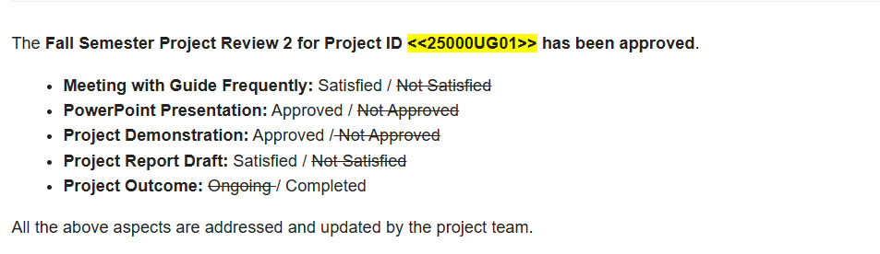
Approval Mail From Guide
Approval obtained from the project guide for the title, objectives, scope and expected outcome.
[Paste the approval e-mail screenshot here]

Slide 3
Aim
To design and implement an AI-driven SecOps agent that sits between Terraform plan generation and CI/CD deployment, and automatically checks every proposed cloud resource against Microsoft's Cloud Adoption Framework (CAF) and Well-Architected Framework (WAF) before the pipeline is permitted to proceed to deployment on Azure, AWS or GCP.

Slide 4
Abstract
Cloud teams ship infrastructure using Terraform through CI/CD pipelines into Azure, AWS and GCP.
Providers publish CAF and WAF as narrative documentation, not enforceable code, so it is rarely checked automatically before deployment.
Existing tools (Checkov, OPA, Sentinel) catch only violations of rules someone already wrote; they cannot reason about framework intent.
Agent SecOps places an AI agent between terraform plan and terraform apply. It reads the plan JSON, evaluates it against CAF/WAF using a policy-aware reasoning layer, and returns pass, block or remediate with a plain-language justification.
Non-compliant infrastructure is stopped before it is ever applied to the cloud - before cost is incurred or exposure occurs.

Slide 5
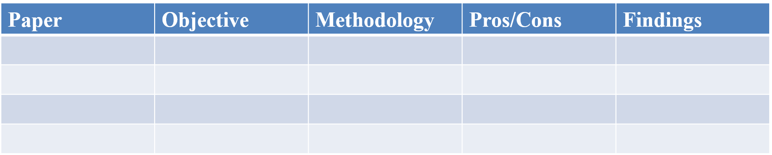

Literature Review
IaC defect studies - Rahman et al. (ICSE'19) identified seven recurring security smells in IaC; replicated across Ansible/Chef (TOSEM'21). GLITCH (ASE'22) showed one normalised representation can serve many IaC technologies.
Policy-as-code tooling - Chiari et al. (ICSA-C'22) surveyed static IaC analysis: almost all production tooling is rule-based, i.e. correctness is an explicit hand-written predicate.
LLMs for code security - Lewis et al. introduced RAG; Pearce et al. (S&P'22) showed model-generated code is not automatically secure - motivating our advisory-by-default design.
Closest prior work - GenKubeSec (2024) for Kubernetes and Vo et al. (COMPSAC'25) for Terraform show LLMs out-detect rule-based scanners, but both analyse static artefacts, not an enforcing pipeline gate.

Slide 6
Research Gap
Rule-bound detection - static tools detect only violations of rules already hand-authored; uncodified framework guidance is invisible, and rule sets must be maintained per cloud provider.
Analysis without enforcement - recent LLM work (GenKubeSec; Vo et al. 2025) analyses static artefacts, but is not embedded as an enforcing control inside a CI/CD pipeline.
No framework grounding - no existing study maps findings to the specific pillars of Microsoft's CAF and WAF.
Single-cloud scope - no demonstrated gate normalises Azure, AWS and GCP so that one rule serves all three.
This project addresses all four gaps simultaneously.

Slide 7
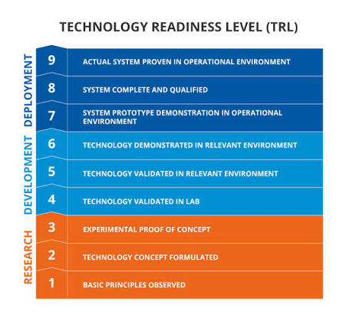

Objectives
O1 - Parse Terraform plan JSON and evaluate every resource against CAF governance areas and the six WAF pillars.
O2 - Normalise Azure, AWS and GCP resource types into canonical kinds so gate logic stays cloud-agnostic.
O3 - Implement a policy-aware reasoning layer that reports violations of framework intent no rule encodes.
O4 - Integrate as an enforcing GitHub Actions gate: apply is unreachable on a block verdict.
O5 - Quantify detection rate, false positives and the marginal gain of reasoning over rules alone.
O6 - Validate against a live Azure subscription at negligible cost.
Identified: Sustainable Development Goals | | Outcomes ((Patent / Conference (Scopus)
/ Journal (Scopus) / Start-up/ Product/ Others}

Slide 8
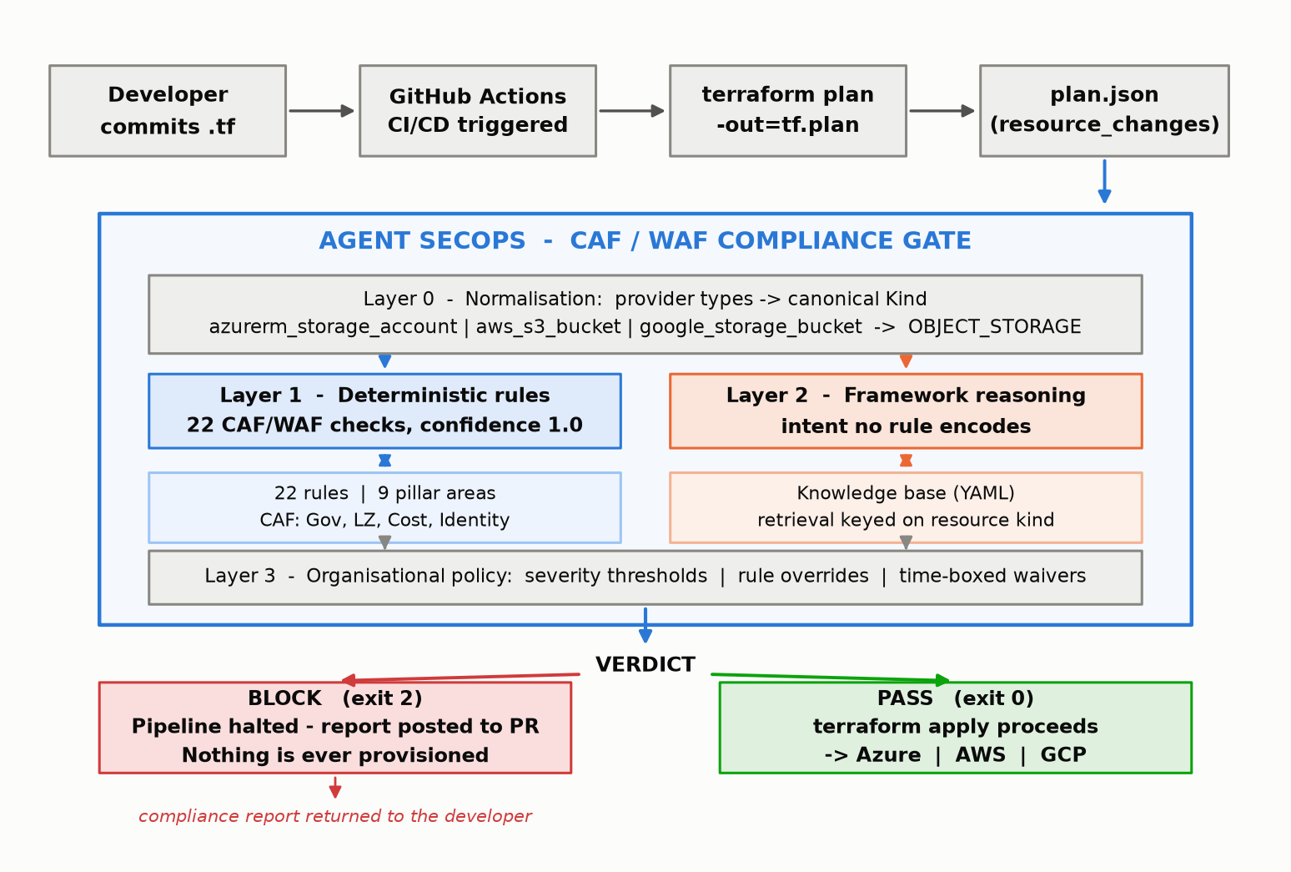
Framework/Architecture/Block Diagram
Developer commits .tf -> GitHub Actions -> terraform plan -> plan.json
Layer 0 - Normalisation: provider types collapse to canonical kinds (azurerm_storage_account / aws_s3_bucket / google_storage_bucket -> OBJECT_STORAGE).
Layer 1 - Deterministic rules: 22 CAF/WAF checks, confidence 1.0; only these may block by default.
Layer 2 - Framework reasoning: retrieves pillar guidance indexed by resource kind; reports intent violations no rule encodes.
Layer 3 - Policy: severity thresholds, rule overrides, expiring waivers.
BLOCK -> pipeline halts, report posted to PR, nothing deployed. PASS -> terraform apply proceeds to Azure / AWS / GCP.

Slide 9
Functional Requirements
FR1 Plan ingestion - accept terraform show -json output; reject malformed input with an actionable message.
FR2 Normalisation - map Azure/AWS/GCP types to canonical kinds; handle create, update, replace, delete.
FR3 Deterministic evaluation - 22 rules, each returning rule id, pillar, severity, explanation and remediation.
FR4 Framework reasoning - retrieve relevant guidance; never duplicate a rule finding.
FR5 Policy - severity thresholds, rule overrides, time-boxed waivers from external configuration.
FR6 Verdict - aggregate to pass / remediate / block, exposed as a process exit code (0 / 1 / 2).
FR7 Reporting - Markdown for the PR, JSON for machines, SARIF 2.1.0 for the Security tab.
FR8 Pipeline integration - gate positioned between plan and apply; blocks apply on a block verdict.

Slide 10
Modules
M1 Plan parser and data model - agent/plan_parser.py, agent/models.py (Akshat Gupta)
M2 Deterministic rule engine - agent/rules/ : 7 CAF + 15 WAF rules (Akshat Gupta)
M3 Knowledge base and reasoning layer - agent/knowledge/caf_waf_kb.yaml, agent/reasoner/ (Gaurish Todi)
M4 Orchestration and policy engine - agent/engine.py, agent/config.py (Gaurish Todi)
M5 Evaluation harness and dashboard - scripts/benchmark.py, dashboard/ (Gaurish Todi)
M6 Reporting and CLI - agent/report.py, agent/cli.py (Bhumika Singh)
M7 CI/CD pipeline and cloud infrastructure - .github/workflows/secops-gate.yml, infra/demo/, scripts/azure-*.sh (Bhumika Singh)

Slide 11
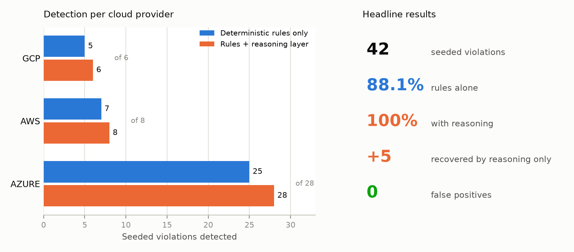
Experiments and Results
Test set: 42 hand-labelled seeded violations across Azure, AWS and GCP, plus a compliant module as the false-positive control.
Deterministic rules alone: 37 / 42 detected (88.1%) - approximately what a static scanner provides.
Rules + reasoning layer: 42 / 42 detected (100%).
Marginal contribution of reasoning: 5 violations recoverable only by reasoning over framework guidance - the core research claim, quantified.
False positives on the compliant module: 0. Median gate latency: under 10 ms. Automated tests: 63 passing.
Live validation: gated and approved a real Azure deployment of 4 resources; steady-state cost approximately Rs. 4 per month.

Slide 12
Conclusion
A working proof-of-concept gate now intercepts real Terraform plans inside GitHub Actions and returns pass / remediate / block against CAF and WAF before any resource is created.
The three-layer design keeps authority with deterministic rules while the reasoning layer widens coverage - measured at +5 violations with zero false positives.
Cloud-agnosticism is demonstrated, not asserted: one rule set gates Azure, AWS and GCP plans, verified by automated test.
Status advanced from TRL 3 (analytical proof of concept) to TRL 4 (component validation in a laboratory environment).
Future work: replace self-authored ground truth with an independent corpus, measure LLM-reasoner precision at volume to justify enabling it as a blocking control, and deepen AWS and GCP rule content.

Slide 13
References
[1] A. Rahman, C. Parnin, and L. Williams, "The seven sins: Security smells in infrastructure as code scripts," in Proc. IEEE/ACM ICSE, 2019, pp. 164-175.
[2] N. Saavedra and J. F. Ferreira, "GLITCH: Automated polyglot security smell detection in infrastructure as code," in Proc. IEEE/ACM ASE, 2022, pp. 1-12.
[3] M. Chiari, M. De Pascalis, and M. Pradella, "Static analysis of infrastructure as code: A survey," in Proc. IEEE ICSA-C, 2022, pp. 218-225.
[4] P. Lewis et al., "Retrieval-augmented generation for knowledge-intensive NLP tasks," in Proc. NeurIPS, vol. 33, 2020, pp. 9459-9474.
[5] H. Pearce, B. Ahmad, B. Tan, B. Dolan-Gavitt, and R. Karri, "Asleep at the keyboard? Assessing the security of GitHub Copilot's code contributions," in Proc. IEEE S&P, 2022, pp. 754-768.
[6] E. Malul, Y. Meidan, D. Mimran, Y. Elovici, and A. Shabtai, "GenKubeSec: LLM-based Kubernetes misconfiguration detection, localization, reasoning, and remediation," arXiv:2405.19954, 2024.
[7] Q.-H. Vo, H. Dao, and K. Fukuda, "Harnessing the power of LLMs for code smell detection in Terraform infrastructure as code," in Proc. IEEE COMPSAC, 2025, pp. 533-542.

